Slide 1
E-TDS ;DaGwL tflnddf ;xeflu ;Dk')f{nfO{ xflb{s :jfut ub{%f} .
cfGtl/s /fh:j sfof{no bdf}nL

Slide 2
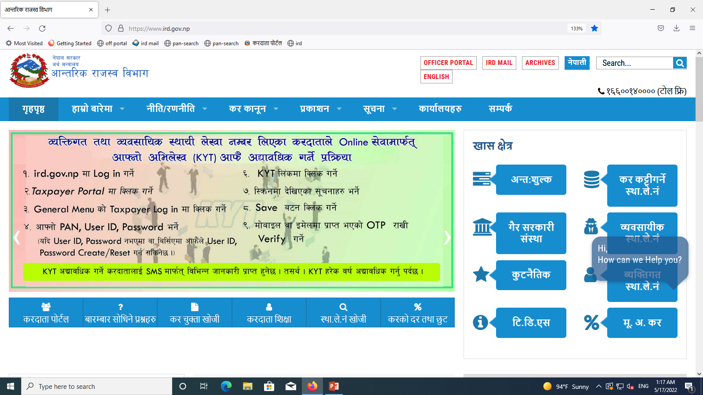
E-TDS ljj/)f k|lji^ ug]{ tl/sf
TDS ug]{ kmd{÷;+:yf÷lgsfon] clgjfo{ Kofg lnO{ ;f]xL Kofg gDa/ /fvL a}+s ef}r/ e/]sf] x'g'kg]{ .
Type: www.ird.gov.np
Click: s/bftf kf]^{n

Slide 3
Click: E-TDS

Slide 4
;lAd;g gDa/ lng] kmf/fd eg]{M
sfof{no jf ;+:yf sf] tkm{af^ eg]{
Click: Register

Slide 5
Click: ^<fG:ofS;g eg]{

Slide 6
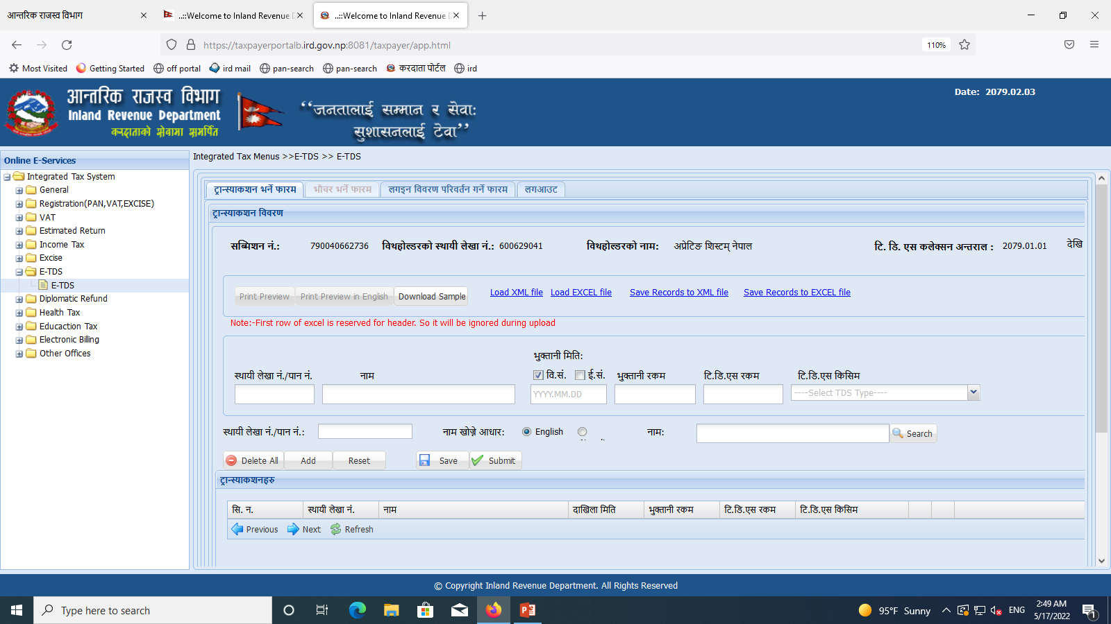

Slide 7
Kofg g+Da/M AolQm jf kmd{sf] -s:sf] ETDS ug]{ xf] To;sf] Kofg gDa/ /fVg]_ / Tab ug]{ .
e'QmfgL ldltM JolQm jf kmd{nfO{ e'QmfgL u/]sf] ldlt .
e'QmfgL /sdM JolQm jf kmd{nfO{ e'QmfgL u/]sf] /sd .
l^l*P; /sdM e'QmfgL lb¤bf sl^[ ul/ /fv]sf] /sd . -1%, 15%_
l^l*P; lsl;dM tnj eQf, k|f=ln=, &]Ssf cGo o:t} h'g xf] Tof] Select ug]{ .
Add
ug]{
o;} ul/ k|Tos sf] Entry ub}{ Add ub}{ hfg] / Save df Click ug]{ .

Slide 8
Click: Download Sample
Save: Excel File

Slide 9
Click: Load Excel File
Click: Browse
Select File &
Click: Open
Click: Load From Excel File

Slide 10
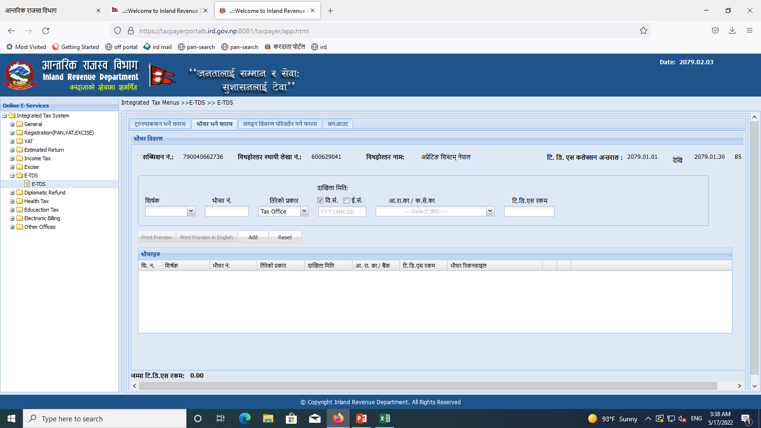
Click: ef}r/ eg]{ kmf/d

Slide 11
^<fG:ofS;g ebf{ Select ul/Psf] lzif{s Select ug]{
a}+s ef}r/df ePsf] gDa/ /fVg] .
o;df a}+s hDdf ePsf] eP a}s ÷ Online Payment dWo h'g xf] Tof] Select ug]{ .
a}+s ef}rf/df ePsf] ldlt /fVg] jf ef}r/ search ubf{ b]lvPsf] ldlt /fVg] .
l^l*P; ul/lbg] sfof{no jf ;+:Yff h'g cf=/f=sf= jf s=;]=sf= cGtu{tsf] xf] ;f]lx sfof{nosf] gfd Select ug]{ .
a}+s ef}r/df pNn]v ePsf] /sd /fVg] .
Click: Add

Slide 12
ef}r/ Search ug]{ tl/sf
Click: s/bftf kf]^{n
Click: General
Click: Payment Voucher Search

Slide 13
/fhZj kf]^{naf^ ef}r/ ebf{ b]lvg] ef}r/ gDa/ /fVg]
Click: Search
a}+s ef}rf/ ebf{ jf /fhZj kf]^{naf^ ef}r/ ebf{ /flvPsf] ldlt
a}+s ef}rf/ ebf{ jf /fhZj kf]^{naf^ ef}r/ ebf{ /flvPsf] /sd
a}+ssf] /ftf] ef}r/df ePsf] gDa/ /fVg] .

Slide 14
Click: Save
Click: Submit

Slide 15
Save u/]sf] ;lAdzg g+= df ePsf] ^<fG:ofSgdf s]xL x]/ km]/ ug'{kg]{ ePdf ;lAdzg g+= / ;'?df /flvPsf] k|of]ustf{sf] gfd, kf;j*{ /flv Login df Click ug]{ .

Slide 16
s'g} klg s/bftfn] cf¤km'n] lt/]sf] -tnj jf sf/f]jf/sf] e'QmfgL lnbf sl^[ ePsf] s/ (TDS) /sd) cf¤km}n] x]g{sf] nflu cf=/f=sf= jf s=;]=sf= af^ agfPsf] k|of]ustf{sf] gfd / kf;j*{ /fVg] / Logon ug]{

Slide 17
E-TDS Self Verify ug]{ k|lqmof
Click: s/bftf kf]^{n
Click : General

Slide 18
Click: Taxpayer Login
sfof{no jf ;+:yfsf]
Reset ubf{ /fv]sf]
Click: Login
cfkm'n] /fv]sf] kf;j*{

Slide 19
Click: TDS Verification To; kl% ;lAd;g g+= /fvL Tab Button lYlr Veryfy df Click ug]{ .
Click: Transactions o;df klxn] Veryfy ePsf] ljj/)f x]g{ ;lsG% .
Click: Withold Information o;df AolQm jf kmd{sf] Kofg g+= df TDS Veryfy ePsf] ljj/)f b]lvG% .
Click: Payment Voucher o;df a}+sdf bflvnf ug'{kg]{ ef}r/ Generate ug{ ;lsg]÷ klxn] e'QmfgL u/]sf] ljj/)f x]g{ ;lsg] .
Click: Add Withholdee Pan in ETDS
ETDS Entry ubf{ s'g} JolQm jf s/bftfsf] Kofg g+= g/flv Verify ePdf pQm s/bftfsf] Kofg g+= Entry ul/lbg .

Slide 20
Kofg g+= gePsf s'g} ef}r/sf] TDS ubf{ ;lAd;g g+= lng] kmf/fddf sfof{no÷;+:yfsf] Kofg g+= g/fVg] / Verify sf] nflu ;DalGwt cf=/f=sf= jf s=;]=sf= af^ Verify u/fpg' kb{% .

Slide 21
wGojfb

